Slide 1




Briefing to Missions
Vibrant Gujarat Global Summit 2017

Slide 2
Summit Schedule – 09 January 2017
Time | Program Details | Venue
1630 | Bhoomi Poojan of Redevelopment of Gandhinagar Railway Station by Hon'ble PM | Gandhinagar Railway Station, GN
1700- 1745 | Inauguration of Global Trade Show by Hon'ble PM (10 min drive from Gandhinagar Railway Station) | Helipad Exhibition Ground, GN
1700 – 1750 (Parallel Program) | High tea to NLs hosted by Dy. CM and Hon'ble Union Minister, Science & Technology | Science City, AMD
1800 - 1830 | Inauguration of BSE & IFSC by Hon’ble PM (15 minute drive from Helipad Exhibition Ground) | GIFT City, GN
1900 | Inauguration of Nobel Prize Series Exhibition by Hon'ble PM (30 minute drive from GIFT City) | Science City, AMD
1915 onwards | Roundtable meeting of NLs with Hon'ble PM | Science City, AMD

Slide 3
Summit Schedule – 10 January 2017
Time | Program Details | Venue | GoI Ministers
0900 - 1230 | Nobel Dialogue (2 consecutive sessions) | SR-4 | Dr Harshvardhan, Hon’ble Minister, S&T
1530 – 1800 | Inauguration of VGGS'17 by Hon’ble PM | Main Convention Hall | Shri Arun Jaitley, Hon’ble Minister, Finance
1830 – 2000 | Global CEO Roundtable Chaired by Hon'ble PM with select 50 top CEOs | Gold Longue (VIP) | Shri Arun Jaitley, Hon’ble Minister, Finance
 | Reception for Dinner Invitees | Amphitheatre
2000 onwards | Dinner hosted by Hon’ble CM for Hon’ble PM, VVIP dignitaries & Global CEOs | MMCC Terrace

Slide 4
Summit Schedule – 11 January 2017
Time | Program Details | Venue | GoI Ministers
Theme and Country Seminars
0930 - 1300 | GST: The Game-changer for Indian Economy | Main Convention Hall | Shri Arun Jaitley, Hon’ble Minister, Finance
 | Smart and Livable Cities: Opportunities and Challenges | SR-1 | Shri M. Venkaiah Naidu, Hon’ble Minister, Urban Development
1000 – 1300 Theme & Country Seminars | Innovation, Startups & Entrepreneurship | Action Seminar Hall (ASH) | Smt Nirmala Sitharaman, Hon’ble Minister or State, C&I
 | Make In Gujarat Series: Biotechnology | SR-4 | Smt Harsimrat Kaur Badal, Hon’ble Minister, Food Processing
 | Smart Villages: Empowering Rural India | SR-2
 | Make In Gujarat Series: Food Processing | SR-3 | Smt Harsimrat Kaur Badal, Hon’ble Minister, Food Processing
 | Country Seminars | CH (Country Halls)
 | B2B meetings | SR-6
3

Slide 5
Summit Schedule -11 January 2017
Time |  | Program Details | Venue | GoI Ministers
1300 – 1400 |  | Lunch | Food Courts
Theme and Country Seminars
1430 – 1730 Theme & Country Seminars | Ease of Doing Business – Regulators as Facilitators |  | SR-3
 | Health for inclusive development |  | SR-1
 | Business Potential of International Financial Services Centre in India - GIFT City |  | SR-4
 | Make In Gujarat Series: Engineering, Heavy Engineering and Automotive |  | SR-2 | Smt Nirmala Sitharaman, Hon’ble Minister of State, C&I
 | Smart and Livable Cities: Opportunities and Challenges |  | Action Seminar Hall (ASH) | Shri M. Venkaiah Naidu, Hon’ble Minister, Urban Development
 | Country Seminars |  | CH (Country Halls)
1430 - 1830 | B2B meetings |  | SR-6
1630 - 1830 | B2G meetings |  | SR-6
3

Slide 6
Summit Schedule -12 January 2017
Time | Program Details | Venue | GoI Ministers
Theme and Country Seminars
1000 – 1300 Theme & Country Seminars | MSME Clusters - Basis of Innovation, Inclusion and Competitiveness | Main Convention Hall
 | Inclusive Growth (Agriculture & Rural Economy) | Action Seminar Hall (ASH)
 | Skilling and Human Capital | SR-3 | Shri Rajiv Pratap Rudy, Hon’ble Minister, Skill Development & Entrepreneurship
 | Make In Gujarat Series: Pharmaceuticals and Medical Devices | SR-1 | Shri Ananth Kumar, Hon’ble Minister, Chemicals & Fertilizers
 | Make In Gujarat Series: - Textiles | SR-2 | Smt Smriti Irani, Hon’ble Minister of Textiles
 | Make In Gujarat Series: Chemicals & Petrochemicals | SR-4 | Shri Ananth Kumar, Hon’ble Minister, Chemicals & Fertilizers
 | Country Seminars | CH (Country Halls)
 | B2B meetings | SR-6
3

Slide 7
Summit Schedule -12 January 2017
Time | Program Details | Venue | GoI Ministers
1300 – 1400 | Lunch | Food Courts
Theme and Country Seminars
1400 – 1630 Theme & Country Seminars | Logistics & Infrastructure | SR-2 | Shri Nitin Gadkari, Hon’ble Minister, Road Transport, Highways and Shipping
 | Make In Gujarat Series: Plastics | SR-4 | Shri Ananth Kumar, Hon’ble Minister, Chemicals & Fertilizers
 | Make In Gujarat Series: Aerospace and Defence | SR-1 | Shri Manohar Parrikar, Hon’ble Minister Defence
 | Country Seminars | CH (Country Halls)
 | B2B meetings | SR-6
1700 onwards | Valedictory Session | Main Convention Hall | Shri Manohar Parrikar, Hon’ble Defence Minister, Shri Piyush Goyal, Hon’ble MoS, Power, Coal, New & Renewable Energy
3

Slide 8
Summit Schedule -13 January 2017
Time | Program Details | Venue
1000 – 1400 | B2B meetings | SR-1,2,6
 | B2G meetings | SR-1,2,6

Slide 9
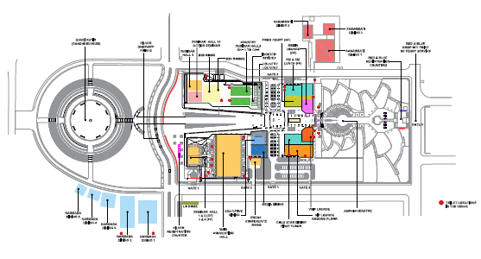
Venue Layout

Slide 10
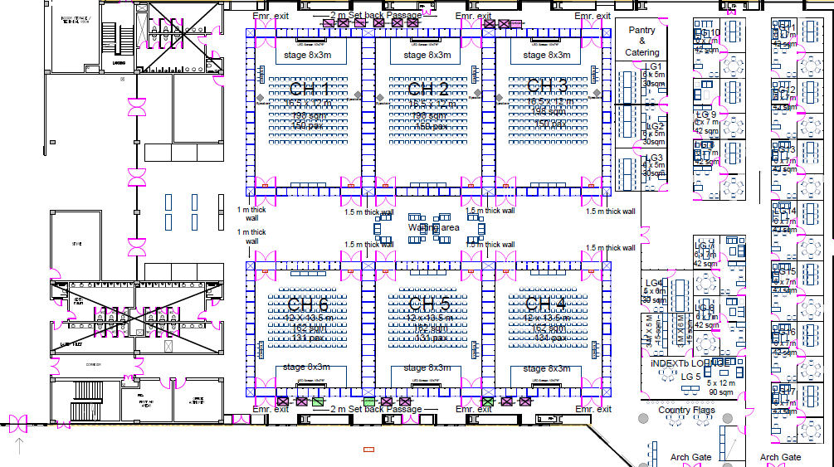
Venue Layout – Country Seminar & Country Business Centers
LG 6 – Australia
LG 7 – Canada
LG 8 – Denmark
LG 9 – France
LG 10 – Japan
LG 11 – The Netherlands
LG 12 – Poland
LG 13 – Singapore
LG 14 – Sweden
LG 15 – UAE
LG 16 – UK
LG 17 - USA

Slide 11
Facilities for Dignitaries
Dignitaries will be provided with lounge facility at Mahatma Mandir
Facilitation for One-on-One meetings
Facilitation for local sight seeing, educational institutions, industrial complexes
Connecting with local business and industry

Slide 12


Vibrant Gujarat Global Trade Show

Slide 13
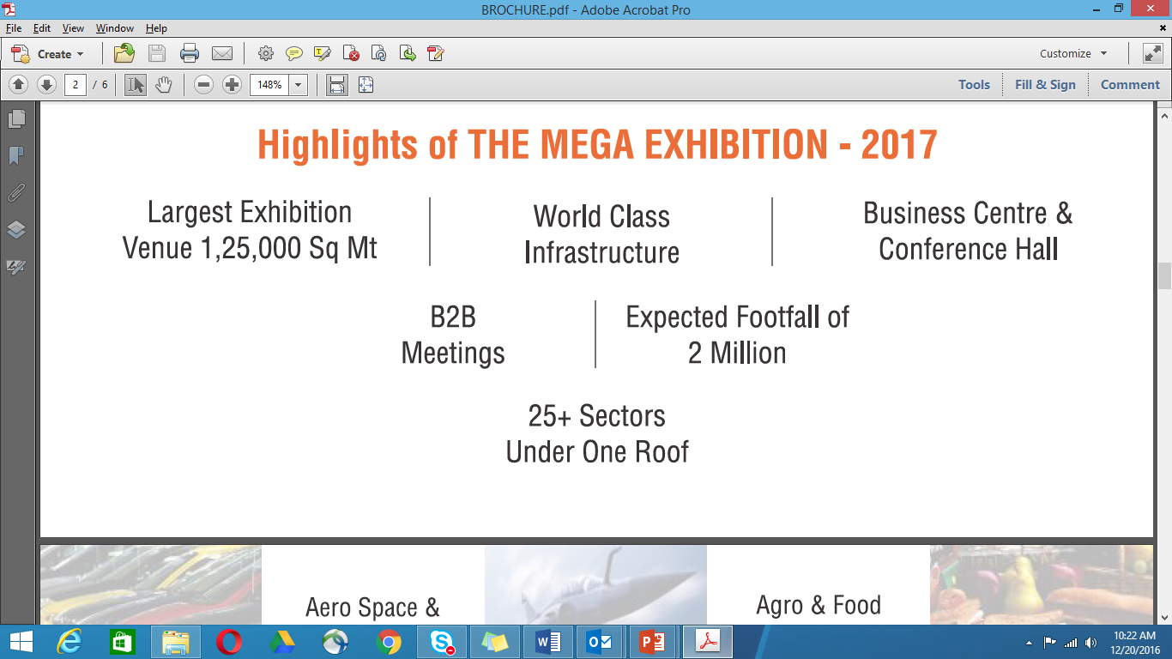
Highlights of Mega Exhibition

Slide 14
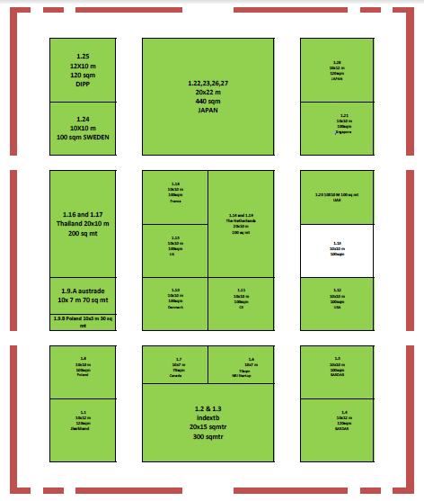
Layout – Country Pavilion
Countries participating:
Japan
France
Sweden
Thailand
Australia
Poland
The Netherlands
United Kingdom
Denmark
Canada
UAE
Singapore
USA

Slide 15
Country Seminars - Schedule
Date & Time | Hall Name (Capacity – persons) | Country
11th Jan'17 (10:00 to 13:00) | Country Hall-1 (150) | France
 | Country hall-2 (150) | UAE
 | Country hall-3 (150) | United States
 | Country hall-4 (100) | Australia
 | Country hall-5 (100) | Sweden
 | Country hall-6 (100) | Poland
11th Jan'17 (14:30 to 17:30) | Country Hall-1 (150) | The Netherlands
 | Country hall-2 (150) | United Kingdom
 | Country hall-3 (150) | Japan
 | Country hall (100) | Saudi Arabia
 | Country hall-5 (100) | Canada
 | Country hall-6 (100) | Reserved
12th Jan'17 (10:00 to 13:00) | Country Hall-1 (150) | Israel
 | Country hall-2 (100) | Free slot
 | Country hall-3 (100) | Free slot
12th Jan'17 (14:00 to 16:30) | Country Hall-1 (150) | Free slot
 | Country hall-2 (150) | Free slot
 | Country hall-3 (150) | Free slot

Slide 16
Country Seminars – National Partners
SN | Country Name | Team members
 |  | iNDEXTb | CII/FICCI
1 | France | Dr. Manish Shah | Ms. Bavleen Kaur, FICCI bavleen.kaur@ficci.com +919910092569
2 | UAE | Viharica Mahida | Mr. Alok Azad, FICCI alok.azad@ficci.com +919540096681
3 | USA | Mr. Paresh Painuly | Sandip Samaddar, FICCI sandip.samaddar@ficci.com +919810311474
4 | Australia | Mr. Hemanshu Bhagat | Varun Gopalakrishan, CII varun.gopalakrishnan@cii.in +91-9879487087
5 | Sewden | Dr. Manish Shah | Ms. Bavleen Kaur, FICCI bavleen.kaur@ficci.com +919910092569

Slide 17
Country Seminars – National Partners
SN | Country Name | Team members
 |  | iNDEXTB | CII/FICCI
6 | Poland | Mr. Kalpesh Sheth | Pankaj Tibak, CII pankaj.tibak@cii.in +91-9825036696
7 | The Netherlands | Mr. Kalpesh Sheth | Pankaj Tibak, CII pankaj.tibak@cii.in +91-9825036696
8 | Japan | Mr. K T Vyas | Raghav Purohit, CII raghav.purohit@cii.in +91-8511118371
9 | UK | Mr. Rupesh Rajpurohit | Saikat Roy Chowdhury, CII saikat.roychowdhury@cii.in +91-9978910012
10 | Saudi Arabia | Mr. Aditya Bhatt | Mr. Goutam Ghosh, FICCI goutam.ghosh@ficci.com +919811337773
11 | Israel | Mr. Rupesh Rajpurohit | Saikat Roy Chowdhury, CII saikat.roychowdhury@cii.in +91-9978910012

Slide 18
Events where presence of Country Heads/VVIPs is solicited
Inauguration of Global Trade Show 2017 (9 January 2017, 1700 hrs)
Inaugural Ceremony of India’s 1st International Exchange at GIFT City (9 January 2017, 1745 hrs)
Lunch at Mahatma Mandir
(10 January 2017, 1330 hrs)
Inaugural Ceremony of Vibrant Gujarat Global Summit 2017 (10 January 2017, 1530 hrs)
Reception cum dinner
(10 January 2017, 1900 hrs onwards)
Respective Country Seminars
Various Theme Seminars
Valedictory Session (12 January 2017, 1700 hrs)

Slide 19
Availability of Hon’ble PM/CM During Lunch/Dinner
Date & Time | Event | Dignitaries | Venue
10th January, 2017
9:00 AM – 1:00 PM | Meetings | Hon’ble PM Hon’ble CM | Mahatma Mandir
1:30 PM – 2:30 PM | Lunch | Hon’ble PM Hon’ble CM | Mahatma Mandir
2:30- 3:15 PM | Free time for political leaders & CEOs to meet each other at Lounge
3:30- 6:00 PM | Inauguration | Hon’ble PM
6:30 – 8:00 PM | CEOs roundtable | Hon’ble PM, Hon’ble CM & Finance Minister | Gold Longue (VIP)
8.00 PM onwards | Dinner hosted by Hon’ble CM for Global CEOs and Dignitaries | Hon’ble PM, Hon’ble CM & Finance Minister | Amphitheatre

Slide 20
Important Coordinators – Government of Gujarat
Sr. no. | Event / Seminar | Coordinators | Contact Details | Email Id
1 | Exhibition Committee | Shri S. J. Haider, IAS, PS, Tourism | (O) +91 79 2325 0706 (M) +91 99784 06080 | sectourism@gujarat.gov.in; sjhaider@gmail.com
 |  | Shri Anupam Anand, IAS, Special Industries Commissioner | (O) +91 79 2325 4822 (M) +91 99784 07791 | sec-com-ind@gujarat.gov.in
2 | Theme Seminars | Dr. C. Chatterjee, Advisor, iNDEXTb | (O) +91 79 2325 1649 (M) +91 99784 07604 | chatterjee@indextb.com
3 | Nobel Prize Series Exhibition | Shri Dhananjay Dwivedi, IAS, Secretary, DST | (O) +91 79 2325 0321 (M) +91 99784 07179 | secdst@gujarat.gov.in
 |  | Shri Roopwant Singh, IAS, Commissioner of Geology & Mining | (O) +91 79 2325 4151 (M) +91 9978406705 | commi-geomine@gujarat.gov.in
4 | Nobel Dialogue | Shri B. B. Swain, IAS, Chief Electoral Officer | (O) +91 79 2325 0318 (M) +91 99784 06155 | ceo_gujarat@eci.gov.in
 |  | Shri Roopwant Singh, IAS, Commissioner of Geology & Mining | (O) +91 79 2325 4151 (M) +91 9978406705 | commi-geomine@gujarat.gov.in

Slide 21
Important Coordinators – Government of Gujarat
Sr. no. | Event / Seminar | Coordinators | Contact Details | Email Id
5 | Investment Intention/MoU Committee | Shri Sanjay Prasad, IAS, PS, Agriculture & Co-operation | (O) +91 79 2325 0801 (M) +91 99784 06348 | secagri@gujarat.gov.in
 |  | Smt. Anju Sharma, IAS, PS, Higher & Technical Education | (O) +91 79 2325 1308 (M) +91 9978405600 | secedu-he@gujarat.gov.in
6 | Airport Facilitation Committee | Shri Milind Torawane, IAS, Secretary (Housing & Nirmal Gujarat) | (O) +91 79 2325 1038 (O) +91 79 2325 1037 (M) +91 99784 06990 | sec-hn-urban@gujarat.gov.in
7 | Country Seminar & B2B and B2G meetings Committee | Mr. Pankaj Kumar, IAS, Principal Secretary, Health & Family welfare Department | (O) +91 79 2325 0502 | sechfwd@gujarat.gov.in
 |  | Mr. Hardik Shah, IAS, Member Secretary, GPCB | (O) +91 79 2323 2152 (M) +91 9978407620 | msgpcb@gmail.com

Slide 22
Important Coordinators – Government of Gujarat
Sr. no. | Event / Seminar | Coordinators | Contact Details | Email Id
8 | One on One Meetings of Hon'ble CM | Mr. L Chuaungo, IAS, PS, GAD | (O) +91 79 2325 0311 (M) +91 98795 65877 | secpers@gujarat.gov.in
 |  | Ms. S. Aparna, IAS, PS to CM | (O) +91 79 2325 0078 | sec2cm@gujarat.gov.in; apstocm@gujarat.gov.in
9 | Protocol & Accommodation & Transport Committee | Shri Manoj Kumar Das, IAS, Principal Secretary, Food, Civil Supplies & Consumer Affairs Department | (O) +91 79 2325 1162 (M) +91 97277 80001 | secfcs@gujarat.gov.in
10 | Hospitality | Shri Raj Gopal, IAS, Principal Secretary, Panchayats, Rural Housing and Rural Development Department | (O) +91 79 2325 1101 (M) +91 99784 06052 | secprh@gujarat.gov.in
 |  | Shri Manoj Aggarwal, IAS, Development Commissioner, Gandhinagar | (M) +91 9978444105 | commi-prh@gujarat.gov.in

Slide 23
Important Coordinators – Government of Gujarat
Sr. no. | Event / Seminar | Coordinators | Contact Details | Email Id
11 | Global CEO Roundtable | Shri Deepak Bagla, CEO Invest India | (M) +91 9811008132 | Deepak.bagla@investindia.org.in
 |  | Shri Vivek Abraham Invest India | (M) +91 92051 92110 | Vivek.abraham@investindia.org.in
 |  | Shri Sujit Gulati, IAS, ACS, EPD | (O) +91 79 2325 0771 (M) +91 99784 06980 | secepd@gujarat.gov.in
 |  | Shri Ajay Bhadoo, IAS, VC&CEO, GMB | (O) +91 79 2323 8363 (M) +91 99784 06358 | vc-gmb@mgujarat.gov.in

Slide 24
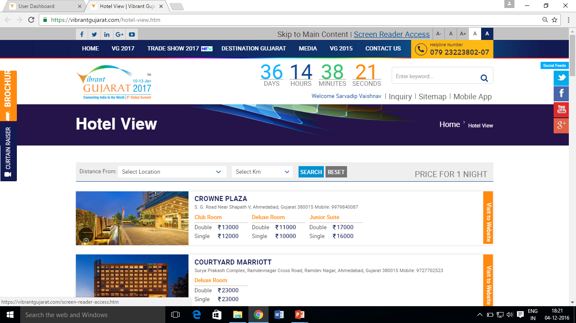
Snapshot of hotel details - www.vibrantgujarat.com

Slide 25
Distance of key hotels from important locations
Sr. No. | Hotel | Distance from Mahatma Mandir (in km) | Distance from Airport (in km)
1 | The Accor Novotel | 29 | 17
2 | The Ummed | 19.5 | 1.5
3 | Radisson Blu | 32 | 14
4 | Courtyard Marriott | 30 | 17
5 | Fortune Landmark | 26 | 9
6 | Crowne Plaza | 30 | 18

Slide 26
Distance of key hotels from important locations
Sr. No. | Hotel | Distance from Mahatma Mandir (in km) | Distance from Airport (in km)
7 | St. Laurn (ex. Regenta) | 26 | 8
8 | Hyatt Regency | 27 | 10
9 | The Pride Plaza | 28 | 16
10 | Lemon Tree Premier - The Atrium | 28 | 21
11 | Hyatt Ahmedabad (Vastrapur) | 28 | 14

Slide 27
Accommodation arrangements made by Gujarat Government
Category of Dignitaries | Planning for Accommodation
Head of the Nation | 1+2 i.e., 1 suite for the Head of the Nation / Delegation and 2 rooms for his / her immediate attaché. Other delegation members will be facilitated.
Ministers of the Foreign Countries | 1+2 i.e., 1 suite for the Minister (Leading the delegation) and 2 rooms for his / her immediate attaché. Other delegation members will be facilitated.
Ambassador/High Commissioner | Accommodation arrangement will be made for Ambassador/High Commissioner only, if requested. Other delegation members will be facilitated.

Slide 28
Accommodation arrangements made by Gujarat Government
Category of Dignitaries | Planning for Accommodation
Consul General | Accommodation arrangement of CG will be made, if requested. Other delegation members will be facilitated.
Nobel Laureates / Nobel Media | Suites for Nobel Laureates Rooms for Nobel Media
Head of Provincial Governments / Mayor from the Foreign Countries | Accommodation arrangement will be made on request. Other delegation members will be facilitated

Slide 29
Accommodation arrangements made by Gujarat Government
Category of Dignitaries | Planning for Accommodation
International Speakers of the Seminars | Accommodation arrangement will be made.
International Organisation such as World Bank etc. | Accommodation arrangement for the leader of the delegation, will be made and the other delegation members will be facilitated

Slide 30
Accommodation arrangement status – Partner Countries/Official Delegation
Sr. No. | Country | Name of Hotel
1 | Australia | Courtyard Marriott
2 | Canada | Hyatt (Vastrapur)
3 | Denmark | Crowne Plaza
4 | France | The Accor Novotel
5 | Japan | Courtyard Marriott

Slide 31
Accommodation arrangement status – Partner Countries/Official Delegation
Sr. No. | Country | Name of Hotel
6 | The Netherlands | Crowne Plaza
7 | Poland | Radisson Blu
8 | Singapore | Hyatt (Vastrapur)
9 | Sweden | Hyatt (Vastrapur)
10 | UAE | Hyatt Regency

Slide 32
Accommodation arrangement status – Partner Countries/Official Delegation
Sr. No. | Country | Name of Hotel
11 | UK | Courtyard Marriott
12 | USA | Courtyard Marriott

Slide 33
Accommodation arrangement status – Partner Countries/Official Delegation
Sr. no. | Country | Name of Hotel
13 | Kenya | The Pride Plaza
14 | Lithuania | Lemon Tree - The Atrium
15 | Portugal | The Ummed
16 | Russia | Hyatt Regency

Slide 34
Accommodation arrangement status – Partner Countries/Official Delegation
Sr. no. | Country | Name of Hotel
17 | Rwanda | Fortune Landmark
18 | Serbia | Fortune Landmark and St. Laurn
19 | Republic of Korea | The Fern

Slide 35
Logistics arrangement
Category of Dignitary | Type of Vehicle
Heads of State / Ministers /Chief Minister / Mayor of the Foreign Country | High end car for each dignitary
High Commissioner / Ambassador of the Foreign Mission | High end SUVs
Delegation Members | Coach depends upon the size of delegation
Shuttle bus service from the hotels to Mahatma Mandir (to and fro)

Slide 36
Protocol arrangement
Category of Dignitary | Liaison Officer
Heads of Province / Ministers /Chief Minister / Mayor of the Foreign Country | One Senior Government allotted to each dignitary
High Commissioner / Ambassador of the Foreign Mission | One Senior Government allotted to each dignitary
Delegation Members | Official will be assigned, depends on the strength of the delegation
One Official at the Hotel will be stationed to facilitate smooth check in and check out of important dignitaries

Slide 37
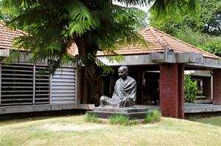
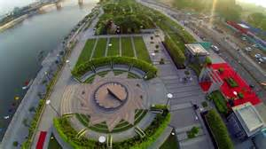
Places to visit in and around Gandhinagar
SABARMATI ASHRAM, AHMEDABAD
A crucial location for India’s independence movement
This was one of the residences of, generally called Mahatma Gandhi, who lived there for about twelve years along with his wife, Kasturba Gandhi.
Worth visiting to understand Gandhiji’s way of life and his philosophies, especially his art of khadi weaving
SABARMATI RIVERFRONT, AHMEDABAD
One of its kind of urban regeneration and environmental improvement initiative, the riverfront provides a meaningful waterfront environment and public space for recreation and leisure along the banks of the Sabarmati River

Slide 38
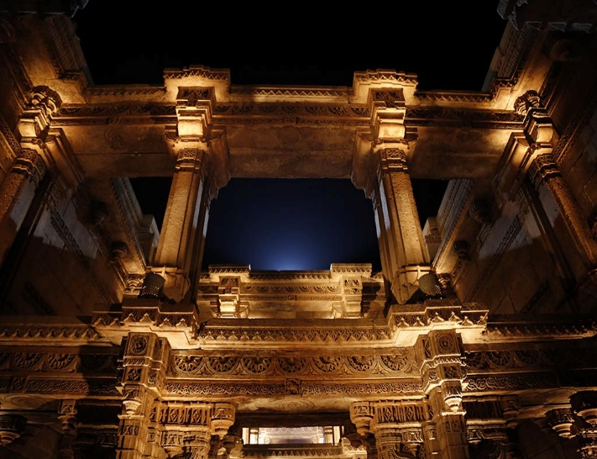
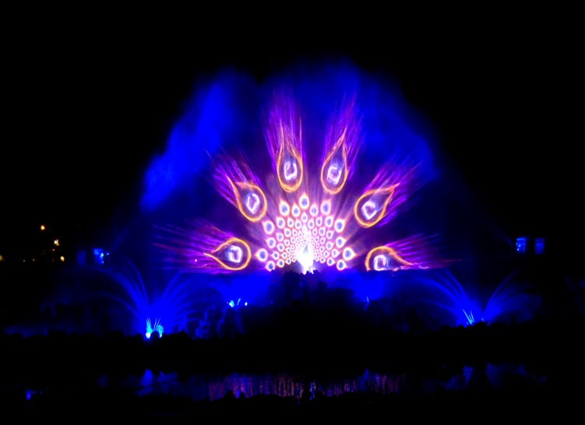
Places to visit in and around Gandhinagar
ADALAJ STEPWELL, GANDHINAGAR
The 'Vav', built in 1499 by Mohammed Begda for Queen Rani Roopba (wife of Veer Singh), is an intricately carved stepwell which is five stories in depth
It is venue for colorful festivals and sacred rituals
WATERSHOW AT AKSHARDHAM TEMPLE, GANDHINAGAR
A breathtaking and enchanting addition to the Swaminarayan Akshardham complex in Gandhinagar. The show reveals India’s ancient secret of inner light.
Many technological elements of Sat-Chit-Anand makes it truly unique in the country, with a 130-feet wide and 70-feet high water screen, around 4,000 nozzles, 2,000 lights, over 100 pumps, 160-feet long sea-of-fire (fire spreading on water) along with several fireballs, three powerful lasers, all enhanced by 7.1 surround sound system.

Slide 39

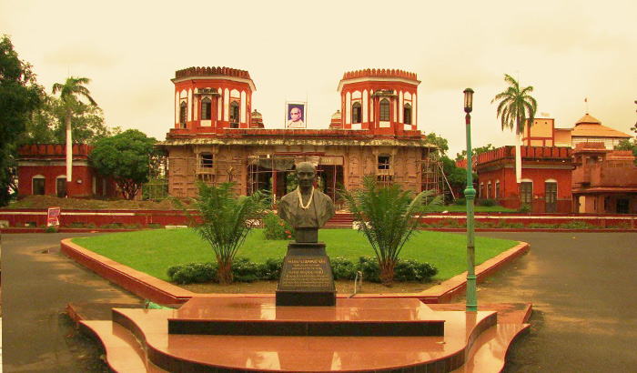
Places to visit in and around Gandhinagar
KITE FESTIVAL, AHMEDABAD
International Kite Event takes place in Ahmedabad (Kite capital of Gujarat) which accommodates visitors from many international destinations.
The International Kite Festival India 2017 is set to display amazing collections of simple and fancy kites in all shapes and sizes. Groups of people participate in high kite flying if size is too big. The sky will be filled with bright colors of kites on banks of Sabarmati (Gandhi to Nehru Bridge). International visitors can learn the Gujarati style of kite flying with screams all over the place.
SARDAR VALLABHBHAI PATEL MUSEUM, AHMEDABAD
The Sardar Vallabhbhai Patel National Memorial is a museum and exhibition centre dedicated to Sardar Vallabhbhai Patel at Moti Shahi Mahal, Ahmedabad.
The palace was built in 1622 by the Mughal Emperor Shah Jahan (1616-1622) to give work to the poor during a season of scarcity

Slide 40
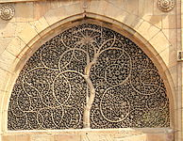
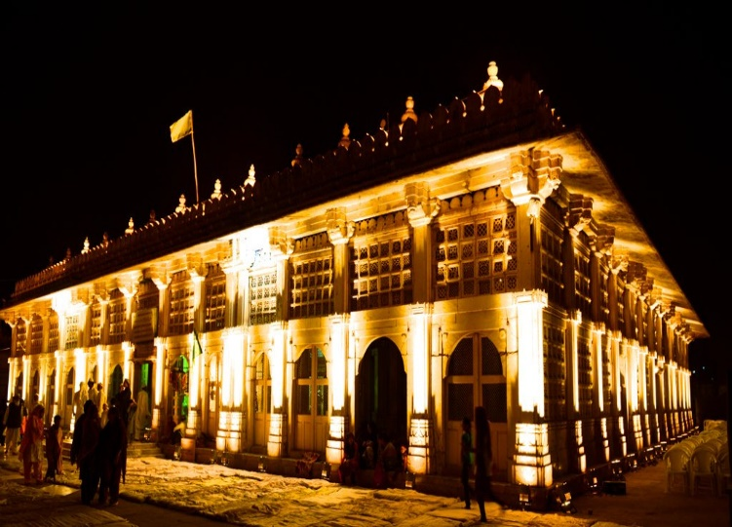
Places to visit in and around Gandhinagar
SIDI SAYED MOSQUE, AHMEDABAD
The Sidi Saiyyed Mosque, more popularly known as Sidi Saiyyed Ni Jaali, built in 1573, is one of the most famous mosques of Ahmedabad.
The mosque is entirely arcuated and is famous for beautifully carved ten stone latticework windows (jalis) on the side and rear arches.
SARKHEJ ROZA, AHMEDABAD
Sarkhej Roza is a mosque and tomb complex located in the village of Makarba
The complex is known as "Acropolis of Ahmedabad", due to 20th century architect Le Corbusier's famous comparison of this mosque's design to the Acropolis of Athens
The Sarkhej Roza complex has been interpreted as being composed of both 'jism'(body) and 'ruh'(spirit), giving it the qualities of a human being

Slide 41
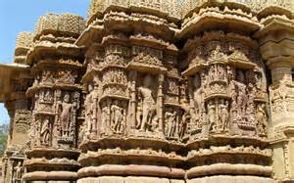
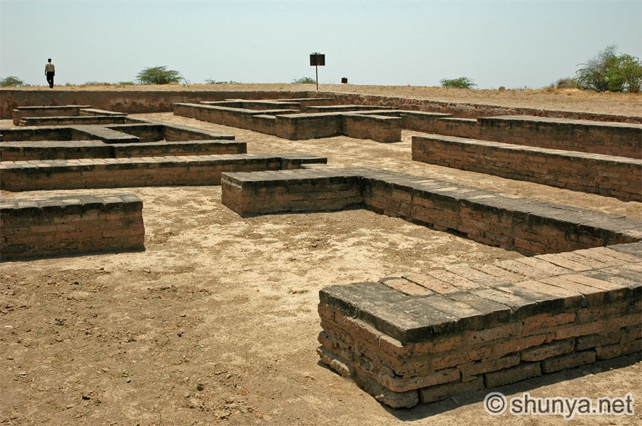
Places to visit in and around Gandhinagar
MODHERA SUN TEMPLE, MODHERA
Exclusively carved temple complex and magnificently sculpted kund are jewels in the art of masonry of Solanki period, also known as the Golden Age of Gujarat
Remains of the Sun Temple are relics of the time of Vedic gods
LOTHAL (HARAPPAN HERITAGE SITE), AHMEDABAD
One of the most prominent cities of the ancient Indus valley civilization
Lothal's dock, the world's earliest known, was a vital and thriving trade centre in ancient times

Slide 42
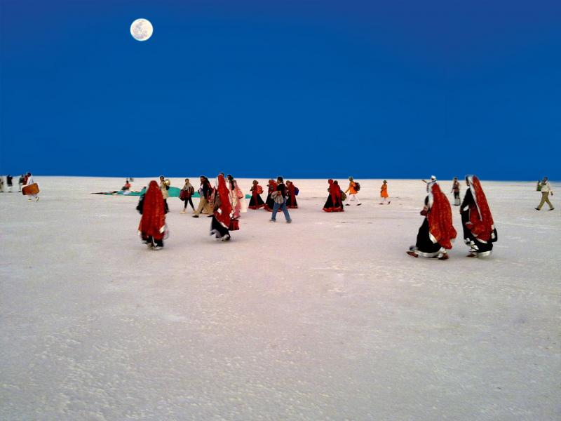
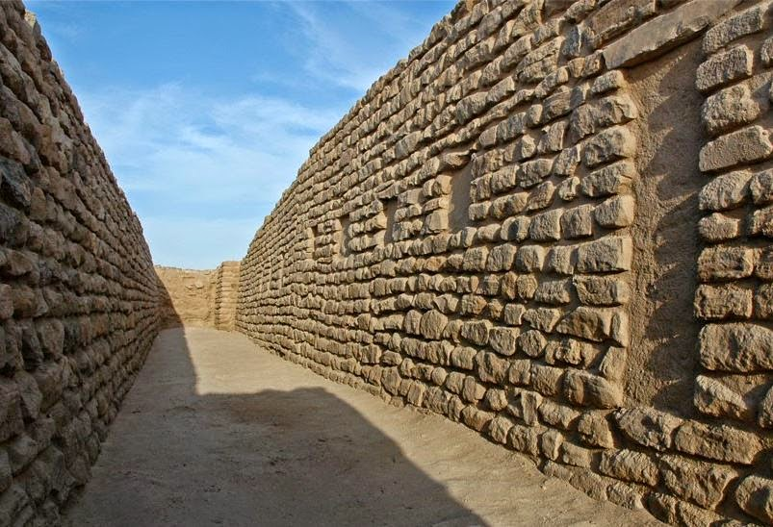
Places to visit in and around Gandhinagar
WHITE DESERT, KUTCHH
The Great Rann of Kutch is a seasonal salt marsh located in the Thar Desert in the Kutch
It is reputed to be one of the largest salt deserts in the world.
Rann Utsav is a carnival of music, dance, natural beauty of White Rann and much more than that when under the full Moon. This time the event is being held from 1st November 2016 to 20th Feb 2017.
DHOLAVIRA (HARAPPAN ARCHEOLOGICAL SITE), KUTCHH
Dholavira is one of the most remarkable excavations of the Indus Valley Civilization or Harappan culture, dating back to 4500 years ago.
This site, in the intense environment that comes with being surrounded by the Great Rann of Kutch, offers a unique insight into the pioneering Harappan mind, with one of the world’s earliest and best planned water conservation systems and what might be the world’s first signboards, written in ancient Indus script.

Slide 43
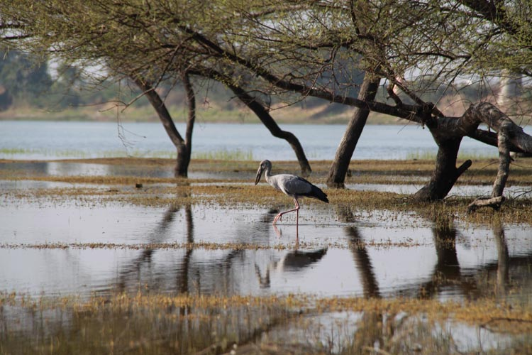
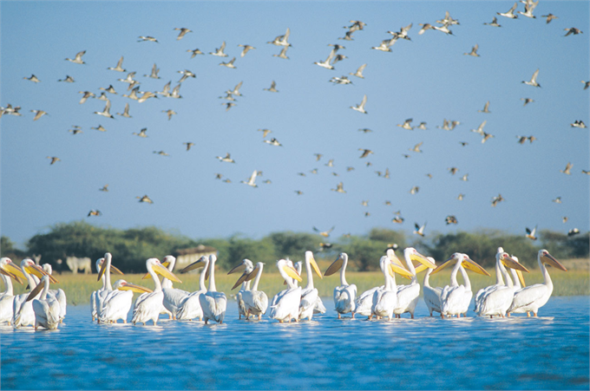
Places to visit in and around Gandhinagar
THOL BIRD SANCTURY, AHMEDABAD
Thol Lake is an artificial lake near Thol village in Kalol.
The two most prominent species of birds recorded in the sanctuary are flamingoes and sarus crane.
The sanctuary is also proposed to be declared an Eco-Sensitive Zone
NALSAROVAR BIRD SANCTURY, AHMEDABAD
A haven for bird-watchers, it is the largest wetland bird sanctuary in Gujarat and one of the largest in India
The lake attracts over 200 species of birds and harbors a variety of flora and fauna

Slide 44
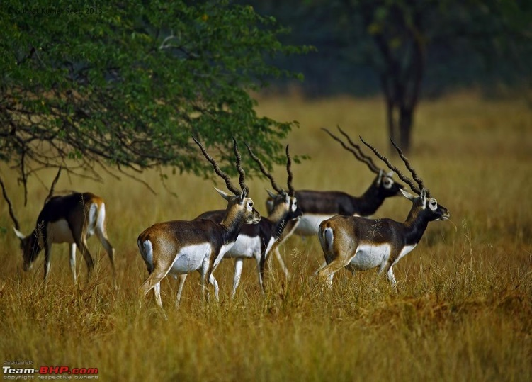
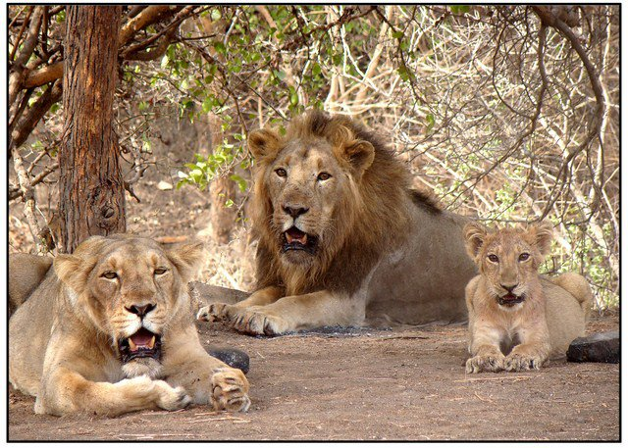
Places to visit in and around Gandhinagar
BLACKBUCK NATIONAL PARK, VELAVADAR
Established in 1976 in the Bhal region of Saurashtra, the park is located around 42 km from the district headquarters city of Bhavnagar.
Hugging the coasts of the Gulf of Khambhat on the south, it is spread over an area of 34.08 sq.km
GIR NATIONAL PARK, JUNAGADH
Located at the foothills of Girnar in Junagadh, Gir National Park is extremely popular for abode of the Asiatic Lions
Close proximity to heritage sites like Mahabat Maqbara, Durbar Hall Museum, Narsinh Mehta's Choro and Ashokan Rock Edicts

Slide 45

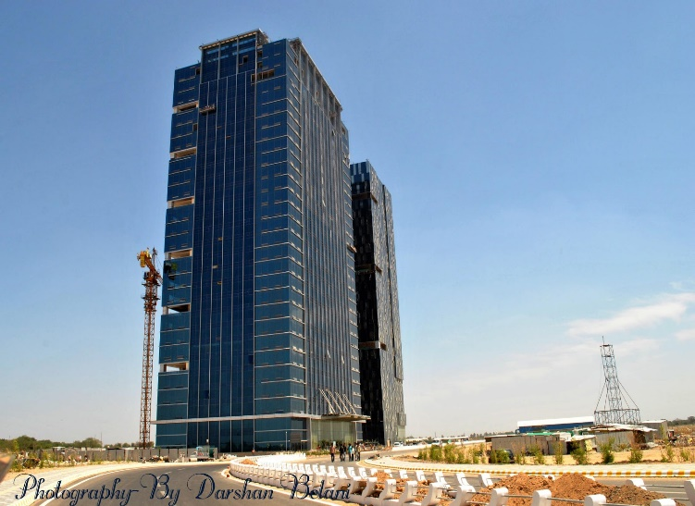
Places to visit in and around Gandhinagar
SCIENCE CITY, AHMEDABAD
Gujarat Science City, is part of a government initiative to draw more students towards education in science.
The center hosts an IMAX 3D theatre, an energy park, a hall of science, Planet Earth, an amphitheater, Life Science Park and dancing musical fountains among others.
The complex will also be hosting a Nobel Prize Exhibition during the Vibrant Gujarat 2017 Summit.
GIFT CITY, GANDHINAGAR
India’s first Smart City that is coming up in Gandhinagar at the Gujarat International Finance Tech City (GIFT City) which is equipped with latest technology known to man.
A Fully integrated city with a walk to work culture, it has the next-in-class infrastructure, connectivity, people, technology and legal framework – emerging as a platform for businesses across the world.

Slide 46
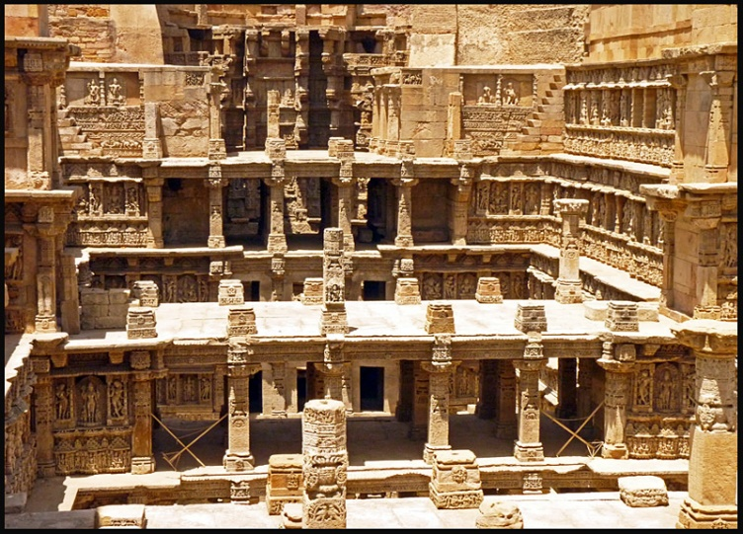
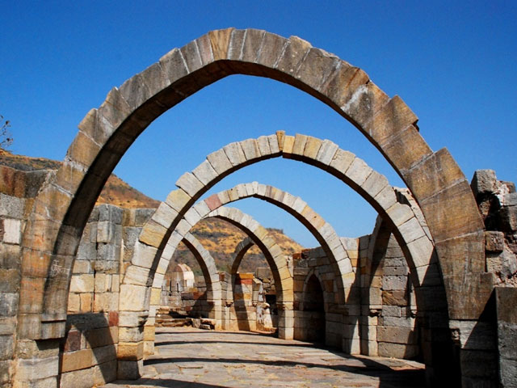
Places to visit in and around Gandhinagar
RANI NI VAV, PATAN
The stepwell, constructed during the period of the Solanki, is called Rani Ki Vav which means Queen’s step well
Inscribed by UNESCO as a World Heritage Site in 2014
CHAMPANER-PAVAGADH ARCHAEOLOGICAL PARK, PANCHMAHALS
Inscribed by UNESCO as a World Heritage Site in 2004
Kalika Mata Temple, located on top of Pavagadh Hill, is an important religious shrine which attracts large number of pilgrims throughout the year

Slide 47
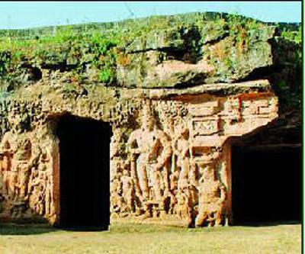
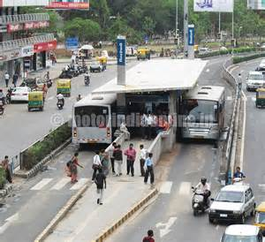
Places to visit in and around Gandhinagar
BUDDHIST CIRCUIT
Buddhist Monastery (Mehsana): The monastery has two votive stupas and an open central court yard, around which an arrangement of cells creates a swastika-like pattern
Dev Ni Mori (Aravalli): Has remains of Buddhist Monastery belonging to 3rd – 4th Century AD
Buddhist Caves (Junagadh):The caves, carved during Emperor Ashoka's period to 1st - 4th Century AD, are 3 separate sites of rooms carved out of stone to be used as monks’ quarters
BRT CORRIDOR, AHMEDABAD
Showcased at 2012 United Nations Climate Change Conference as a 'lighthouse project' as part of the United Nations Secretary General Ban Ki-moon's Momentum for Change Initiative, it is one of the most successful BRT systems in India.
The quality of service and automation in BRT Ahmedabad system, is worth an experience

Slide 48


Key Universities and Institutes in Gujarat (1/5)
Pandit Deendayal Petroleum University (PDPU)
Established: April 2007
Affiliation: University Grants Commission (UGC)
Courses offered: Engineering, arts and management
Distance from Mahatma Mandir: 13 kms
Distance from Airport: 14 kms
Institute of Rural Management (IRMA), Anand
Established: 1979
Affiliation: Autonomous
Courses offered: Management
Distance from Mahatma Mandir: 100 kms
Distance from Airport: 85 kms
3

Slide 49


Key Universities and Institutes in Gujarat (2/5)
Entrepreneurship Development Institute of India (EDII)
Established: 1983
Affiliation: Autonomous
Courses offered: Management
Distance from Mahatma Mandir: 15 kms
Distance from Airport: 6 kms
Gujarat National Law University (GNLU)
Established: 2003
Affiliation: Bar Council of India (BCI) & University Grants Commission (UGC)
Courses offered: Arts, Commerce, Business Administration, Social Work, Science
Distance from Mahatma Mandir: 13 kms
Distance from Airport: 14 kms
3

Slide 50


Key Universities and Institutes in Gujarat (4/5)
National Institute of Fashion Technology
Established: 1986
Affiliation: Statutory
Courses offered: Fashion education in Design, Management and Technology
Distance from Mahatma Mandir: 6 kms
Distance from Airport: 15 kms
National Institute of Design (NID)
Established: 1961
Affiliation: Autonomous
Courses offered: Bachelor and Master of Design, Graduate Diploma Program in Design
Distance from Mahatma Mandir: 31 kms
Distance from Airport: 13 kms

Slide 51


Key Universities and Institutes in Gujarat (3/5)
Indian Institute of Management, Ahmedabad (IIM-A)
Established: 1961
Courses offered: Management
Distance from Mahatma Mandir: 29 kms
Distance from Airport: 14 kms
Nirma University (NU)
Established: 2003
Affiliation: Statutory
Courses offered: Technology, Management, Pharmacy, Science, Law, Architecture
Distance from Mahatma Mandir: 17 kms
Distance from Airport: 17 kms

Slide 52

Key Universities and Institutes in Gujarat (5/5)
Gujarat Technological University (GTU)
Established: 2007
Courses offered: Engineering, Architecture, Management, Pharmacy and Computer Science
Distance from Mahatma Mandir: 19 kms
Distance from Airport: 11 kms
Gujarat Foren­sic Sci­ences Uni­ver­sity
Established: 2008
Affiliation: University Grants Commission (UGC)
Courses offered in Research & Development, Forensic Science and Behavioral Science
Distance from Mahatma Mandir: 5 kms
Distance from Airport: 18 kms
3

Slide 53
Weather forecast – Ahmedabad (temperature in degree celsius)
Mon | Tue | Wed | Thu | Fri
9 Jan. Ahmedabad Sunny Max: 27degree Min: 14 degree | 10 Jan. Ahmedabad Sunny Max: 26 degree, Min: 11 degree | 11 Jan. Ahmedabad Sunny Max: 26 degree, Min: 12 degree | 12 Jan. Ahmedabad Sunny Max: 26 degree, Min: 11 degree | 13 Jan. Ahmedabad Sunny Max: 27 degree, Min: 13 degree

Slide 54
Discount Offers by Partner Airlines – VG 2017
Emirates Airlines
Click on the following link:
http://www.emirates.com/SessionHandler.aspx?pageurl=/IBE.aspx&pub=/in/English&section=IBE&j=f
2. Enter INVGGS6 in the promo-code section
Jet Airways
Please visit the following website: http://www.jetairways.com/EN/IN/Home.aspx
Details:
Promo code | Details | Cabin | Sales start | Sales End | Travel Start | Travel End | Journey | Discount
VIBRANT2017 | 10% discount on Base Fare for travel Ex India to 9W Network | Economy/Premiere | 17-Dec-16 | 18-Jan-17 | 03-Jan-17 | 18-Jan-17 | OW / RT | 10% discount on Base Fare

Slide 55
Discount Offers by Partner Airlines – VG 2017
Air India
5 Percent discount on all Domestic flight from any destination to AMD for travel between 13 Jan to 18 Jan 17.
07 percent discount on Economy class tickets on all International flights to final destination AMD for travel between 13 Jan to 18 Jan 2017
10 Percent discount on Executive class ticket International travel to AMD travel valid 13 Jan to 18 Jan 2017.
The promotion code is made live for bookings effective 1100 hrs on 12 DEC 2016
Whist making the booking the code VGGS17 has to be inserted in the Promo code box on the booking pages.
Visit following URL for booking tickets: WWW.AIRINDIA.IN
Air India code for availing discount is VGGS17

Slide 56
Immediate requirements from Missions
Online registration of all delegation members
Collection of badges from designated areas in Ahmedabad and Gandhinagar
Downloading of VG Application “Vibrant Gujarat 2017” for wi-fi access
Size and detail of official delegation
Size and detail of business delegation
Travel itinerary
Expected meetings – B2B/B2G
Country Seminar preparation (online registration, invitation cards, etc).
GoG Minister and Senior Secretaries will be present during Country Seminar
Minute to minute program of Dignitaries
Request for meeting with Hon’ble PM and Hon’ble CM

Slide 57
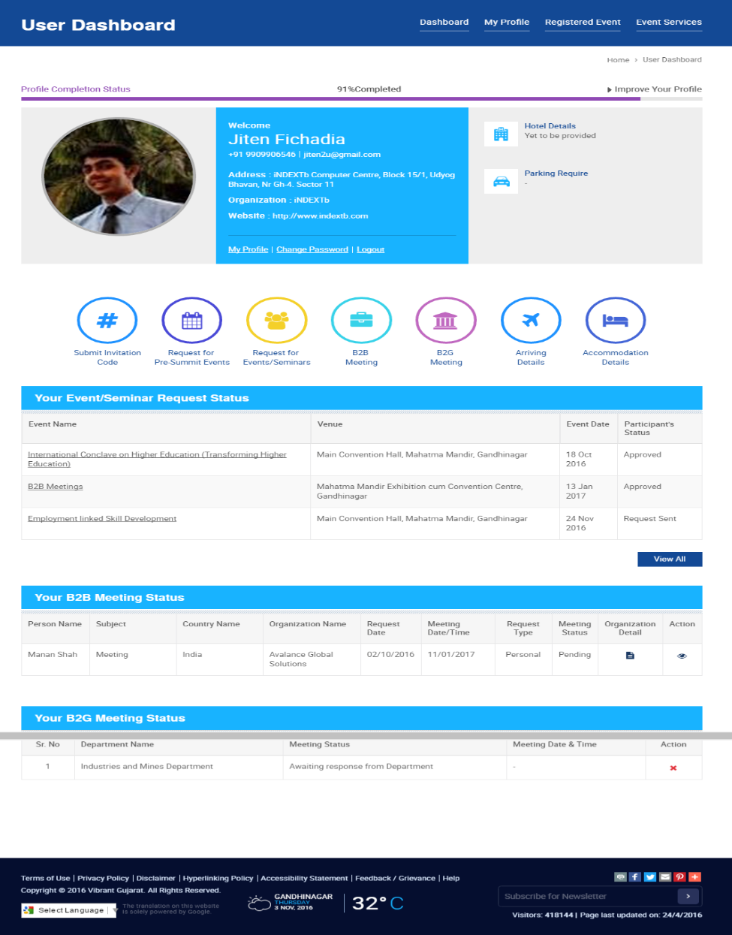

Vibrant Gujarat Global Summit 2017
User Dashboard - sample
You are cordially invited as our esteemed guests to Vibrant Gujarat Global Summit 2017: 10, 11, 12 & 13 Jan 2017 For registration and further information, please visit www.vibrantgujarat.com
hello

